Slide 1
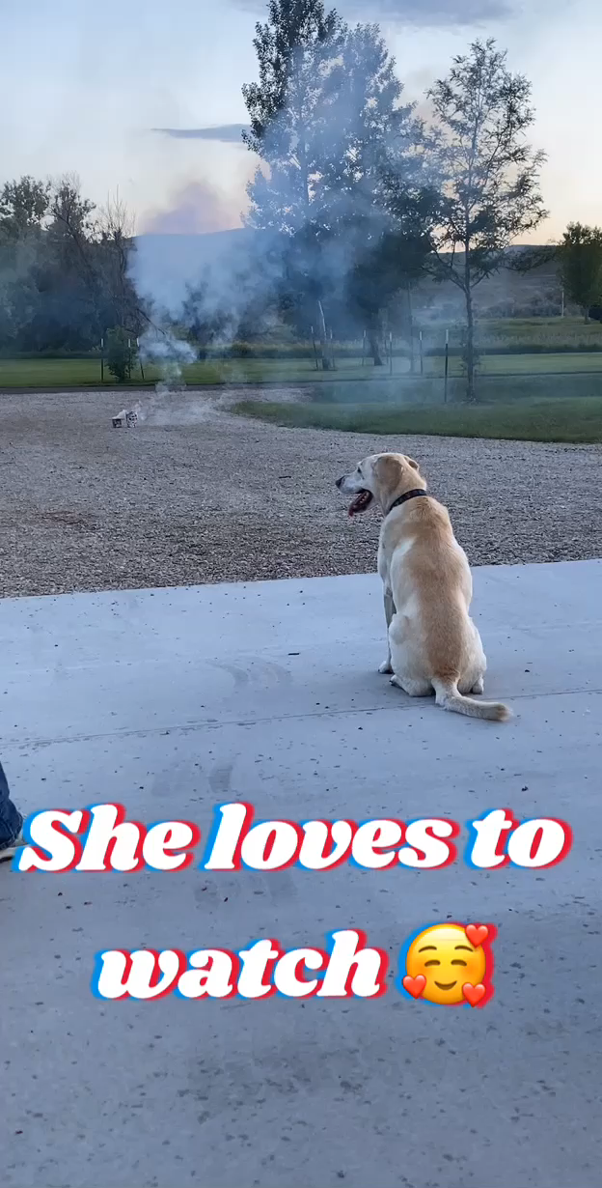

Slide 2
Emotional Habits

Slide 3
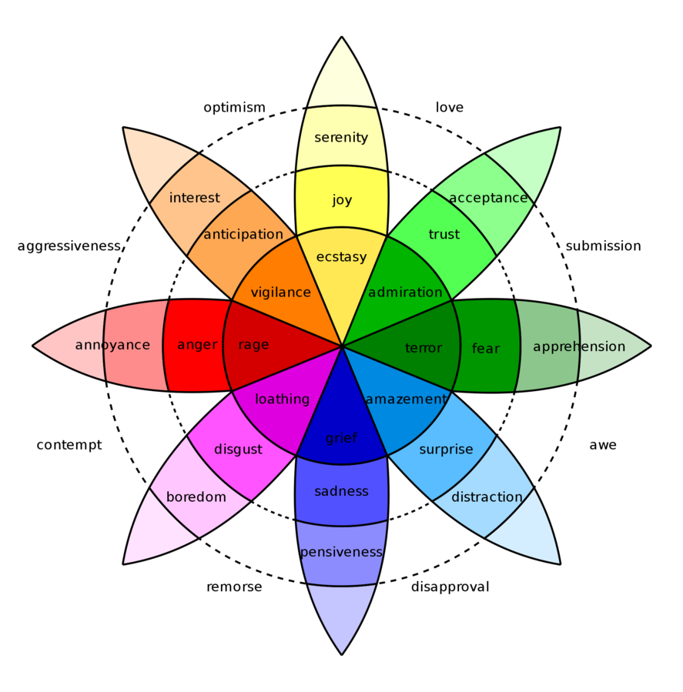

Emotional Writing
Pleasure
Challenge
Growth
Notes:
https://commons.wikimedia.org/wiki/File:Plutchik_Emotions.png

Slide 4
In the long run, the road to productivity will be a long and tedious one unless you can find meaningful ways to pave it with pleasure.
Helen Sword, author of Air & Light & Time & Space: How Successful Academics Write

Slide 5
What aspects of writing give me most pleasure and what pleasurable activities can I integrate to support my productivity? [paraphrase]
Helen Sword, author of Air & Light & Time & Space: How Successful Academics Write

Slide 6
Things To Try

Slide 7
Emotional Habits – Things to Try
Learn from the past
Get frustrated
Find your happy […]
Read a book
The Pleasures of Academe – James Axtell
The Pleasure of the Text – Roland Barthes
Sin and Syntax – Constance Hale
Eats, Shoots & Leaves – Lynne Truss

Slide 8
Emotional Habits – Things to Try
Strategize
Bounce
Celebrate failure
Read a book
Why Write? – Mark Edmundson
Writer’s Guide to Persistence – Jordan Rosenfeld
Toxic Feedback – Joni Cole
Rising Strong – Brené Brown
Flourish – Martin Seligman

Slide 9
Emotional Habits – Things to Try
Re-story your metaphors
Getting started with a new writing project is like…
Getting stuck is like …
Working with a bad collaborator is like …
Sending a paper for grading/review is like …
Receiving negative feedback is like …
Take a walk on the shadow side
Get concrete
Read a book
Introducing Metaphor – Murray Knowles and Rosamund Moon
Women, Fire and Dangerous Things - Lakoff

Slide 10

Publish or Perish

Slide 11

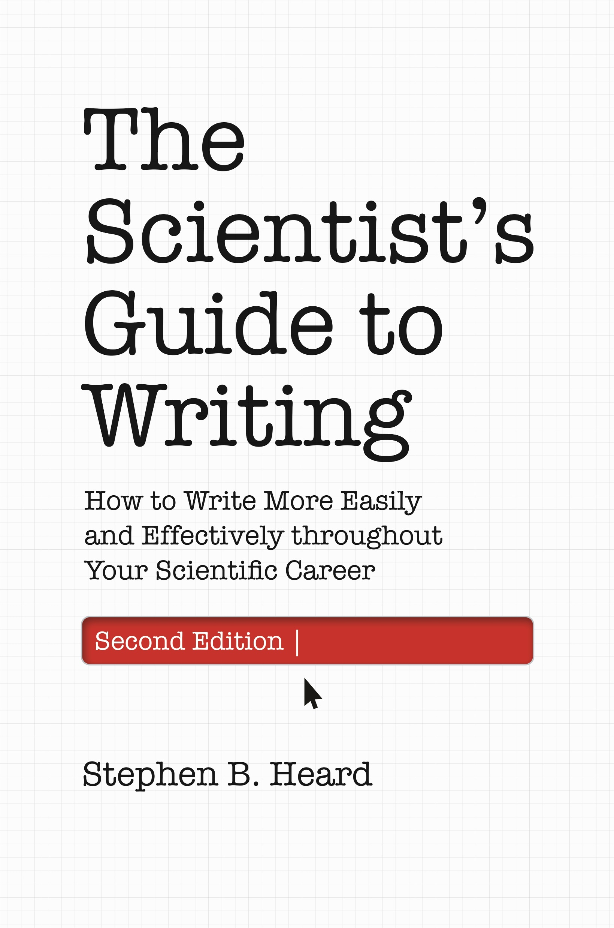

Sources and Inspiration
Stephen Heard, UNB, author of The Scientist Guide to Writing
Irving H. Zucker, UNMC
& Myron Toews, UNMC

Slide 12
Peer Review

Slide 13
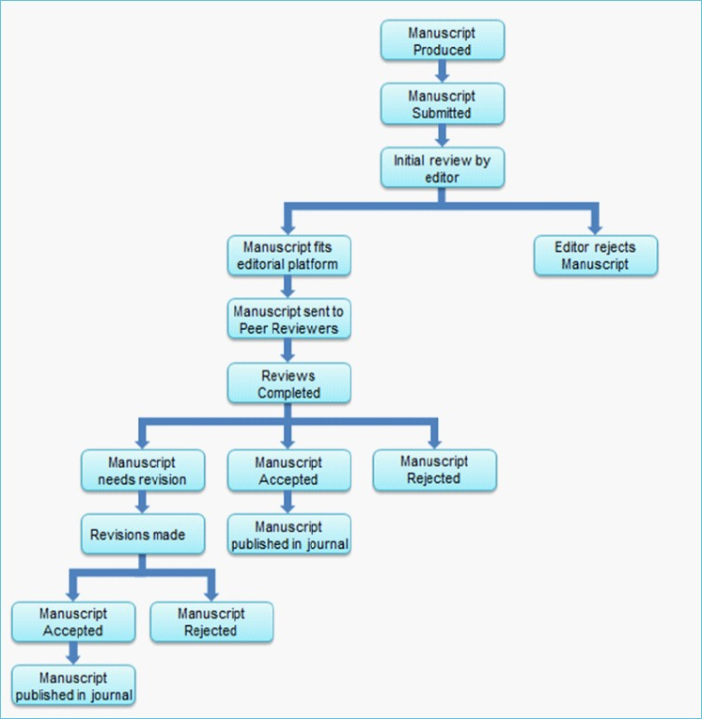
Peer Review Process
Submission
Editorial decision
Reviewer decision
Revisions
Editor/Reviewer decision #2

Slide 14

Peer Review
A system to assess the quality of a manuscript before publication.
Uses independent researchers
Evaluate for originality, validity, and significance

Slide 15

Benefits of Peer Review
Submit better papers
Improves papers
Provides community trust

Slide 16
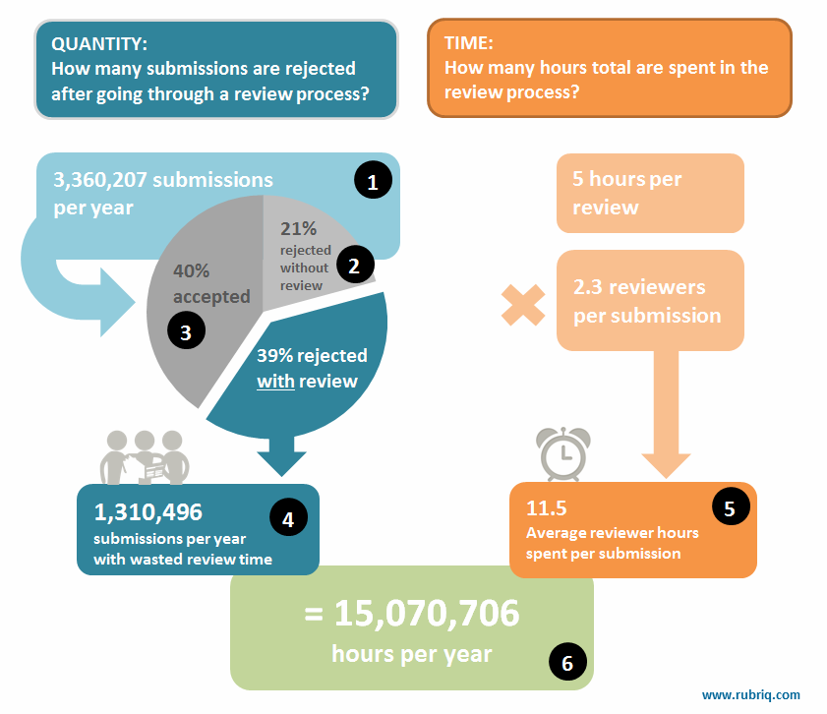
Criticism of Peer Review
Time-consuming
Potential bias
Poor effectiveness

Slide 17


Innovations in Peer Review
https://pubpeer.com/
Comment on papers after publication
https://f1000research.com/
Open peer review

Slide 18
Response to Reviews (R2R)

Slide 19

Initial Response
Erykah Baydu’s Response to Reviews
Satisfying, but not what we’re after
Neal Alves CC BY-NC-ND 2.0

Slide 20

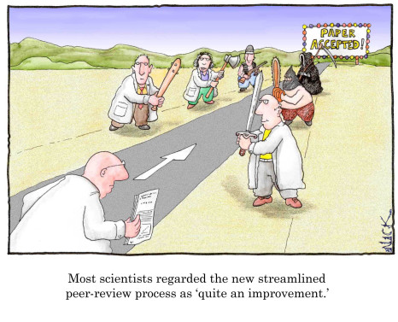
What is the “Response”
Lower case “response to reviews”: the changes you make
Upper case “Response to Reviews”: your description of those changes in a “Response to Reviews” document

Slide 21
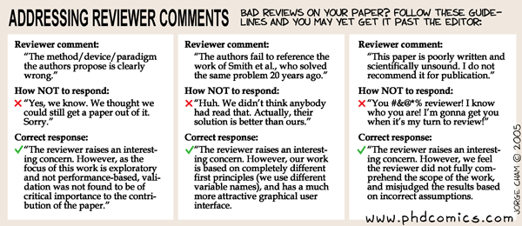
What is a R2R?
Letter addressed to the editor
Reviewers read it too
Summary of major changes
Point-by-point response to each reviewer comment

Slide 22
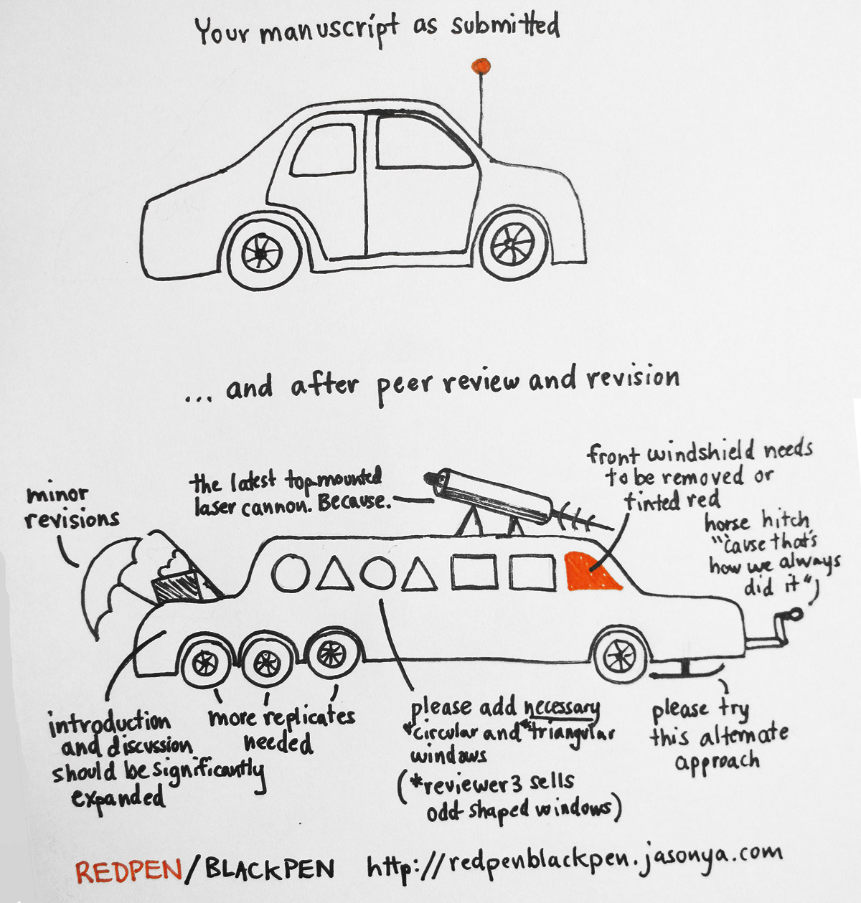
Summary
Addressed to editor
Thanks to editor and reviewers for time and comments
Addresses major changes (approach, analyses, organization)
“below we detail the changes made”
Explain the use of stylistic format to distinguish reviewer comments and your responses

Slide 23
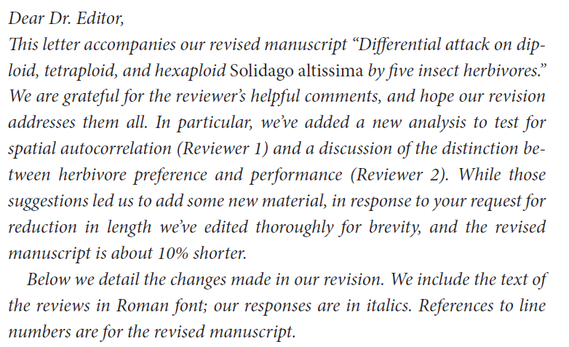
A Wonderfully Titled Manuscript

Slide 24
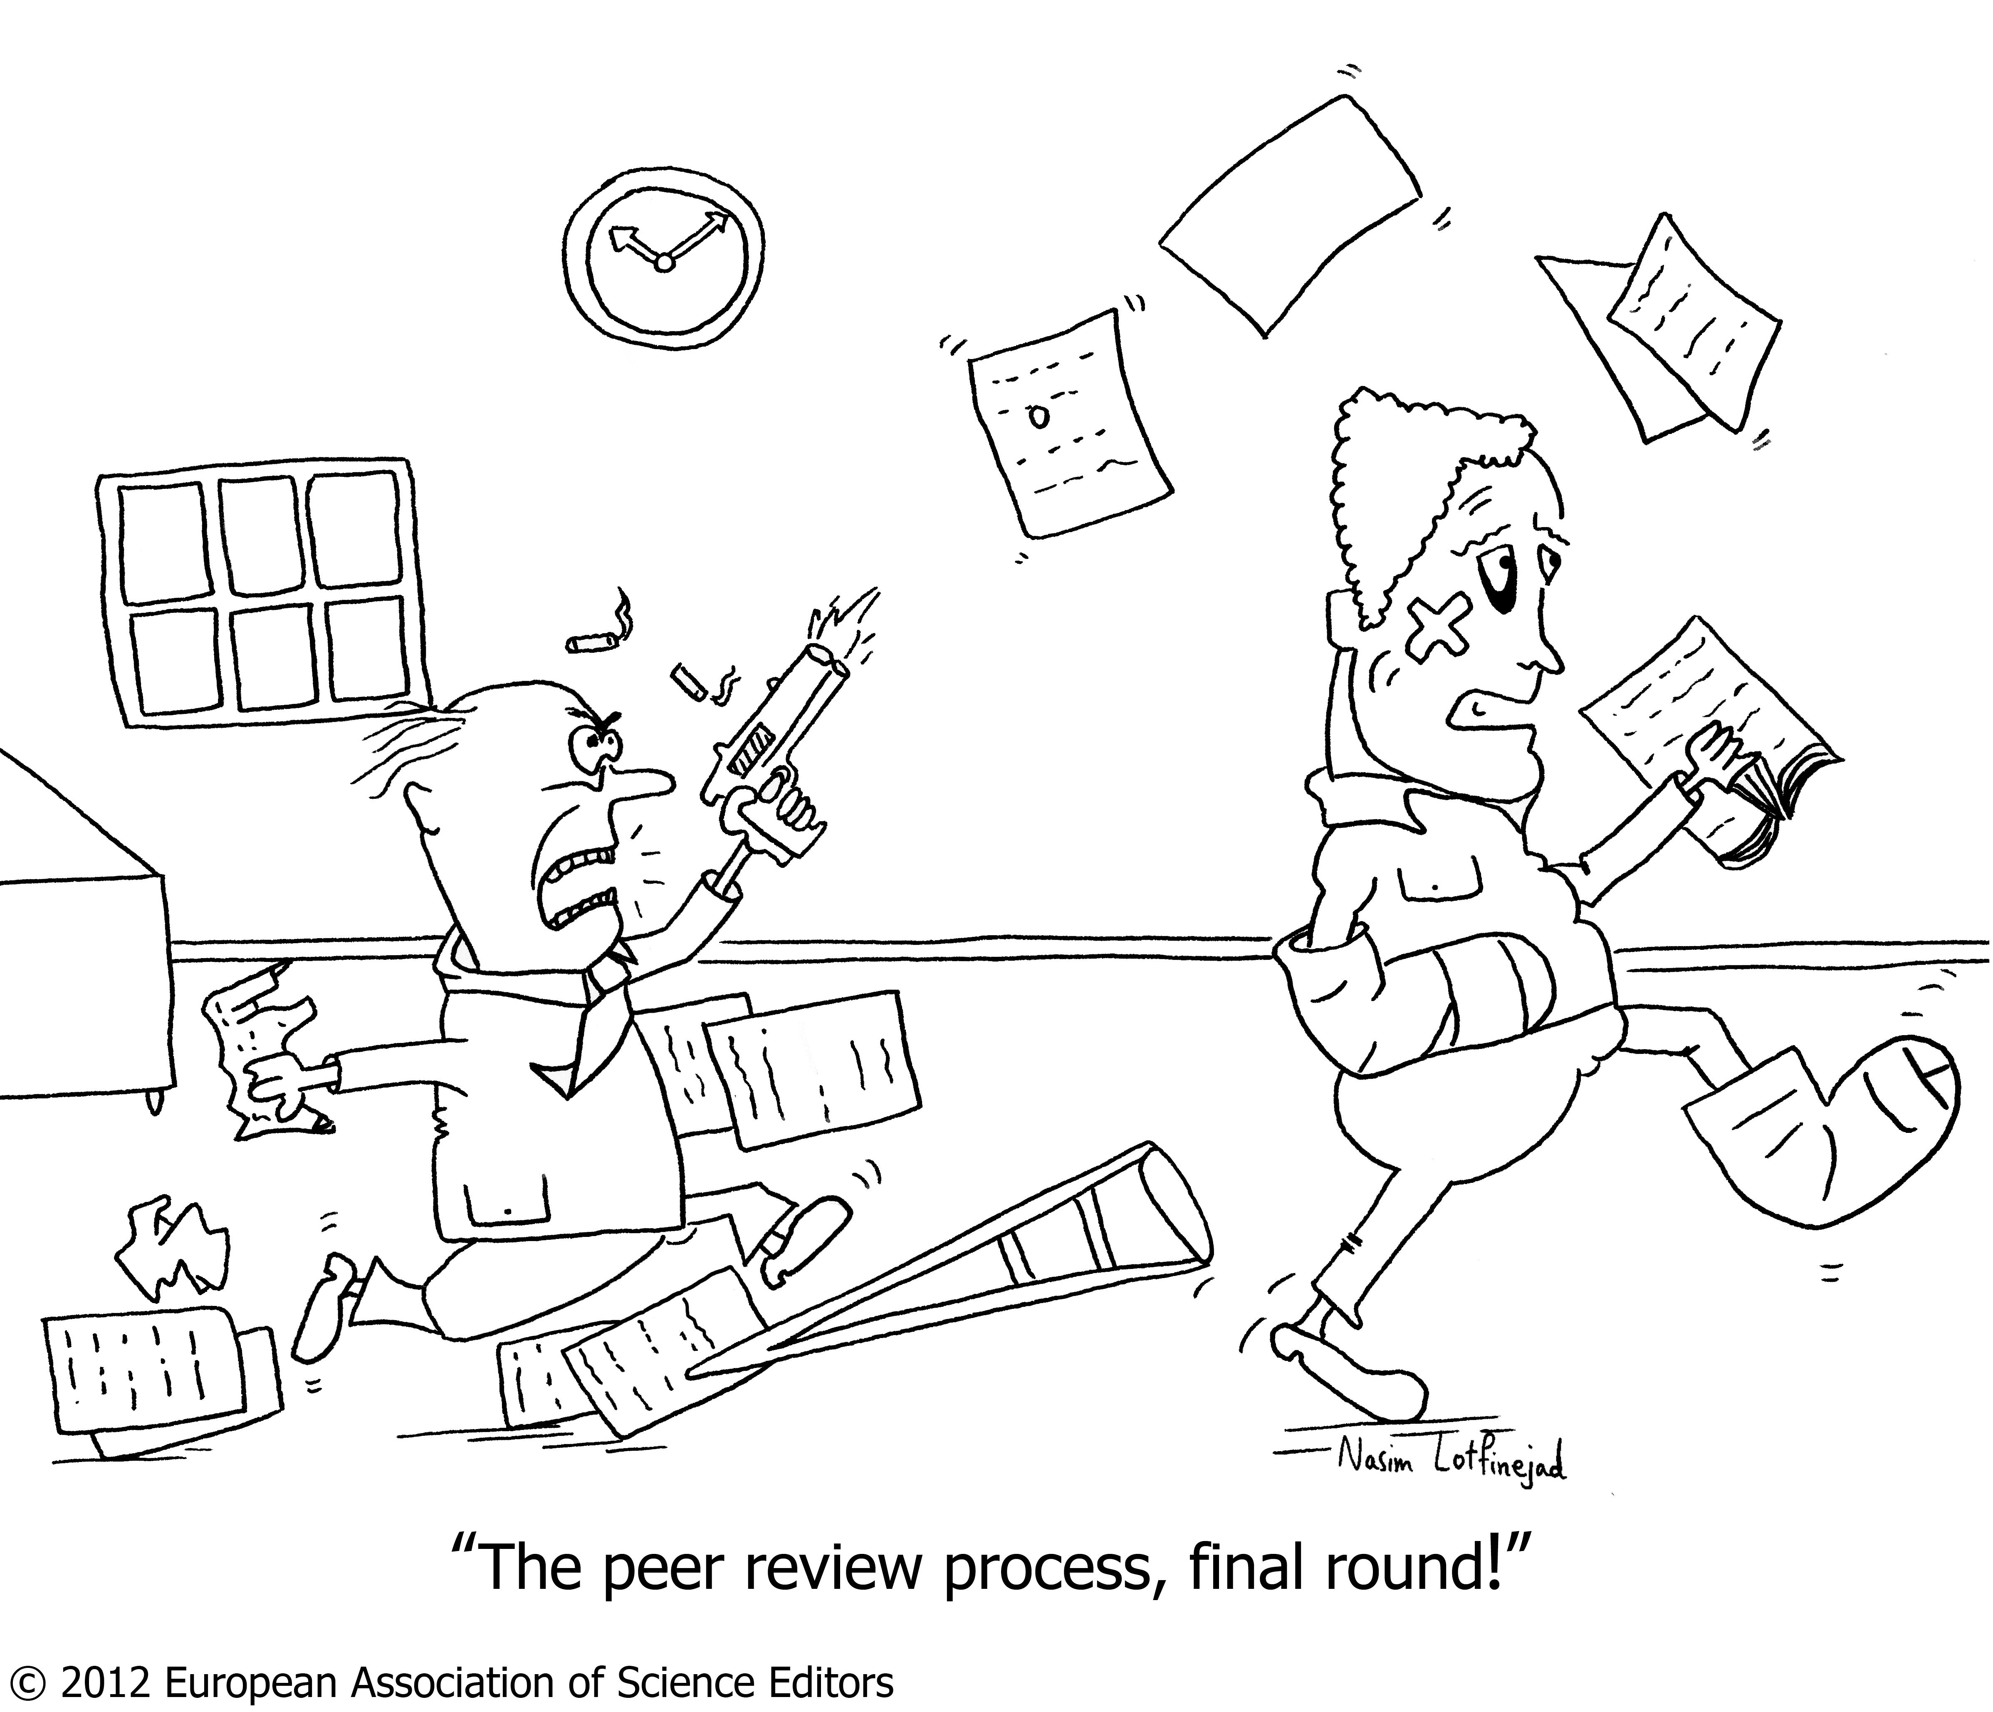
Point by point
Give line numbers for changes
Very short answers are appropriate.
“Done.” “Changed as suggested, thanks.”
Longer answers for descriptions of changes or why you didn’t make a change
Can be very long
Organization and clarity are paramount!

Slide 25
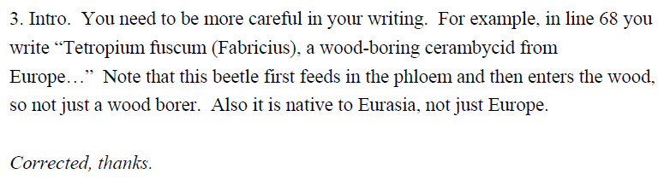
Beetle X

Slide 26
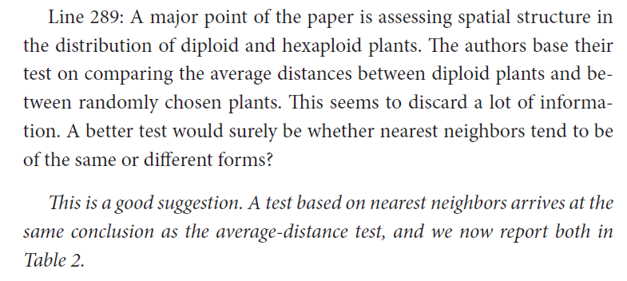

Slide 27
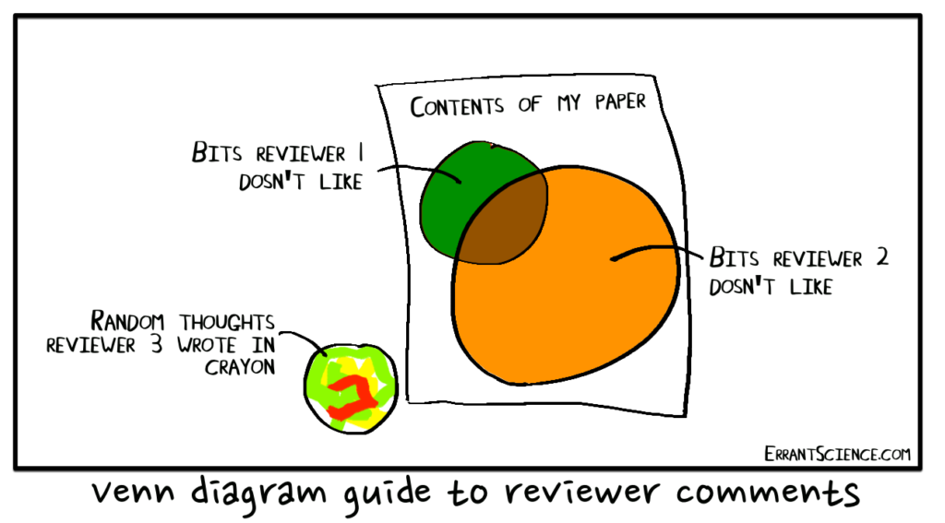
Disagreements with Reviewer
Make the change anyway – if it’s no worse
Rebut in R2R, and make some other change
Rebut in R2R, and leave unchanged
Defer to editor’s judgement

Slide 28
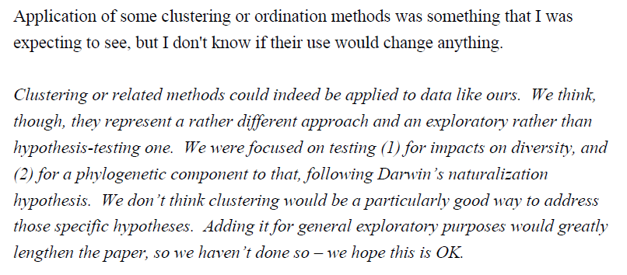

Slide 29
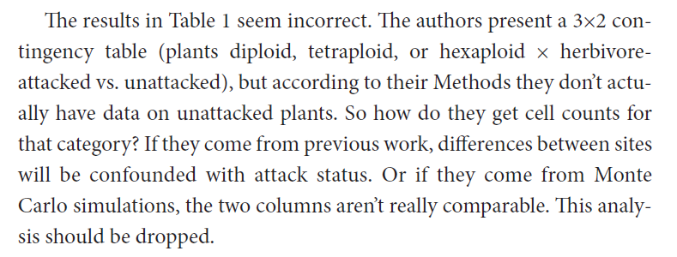
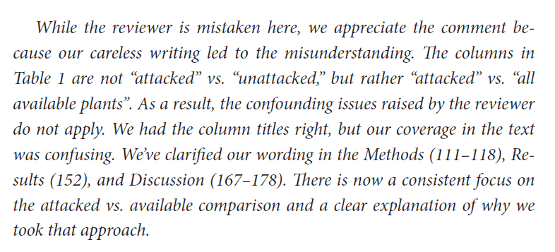

Slide 30
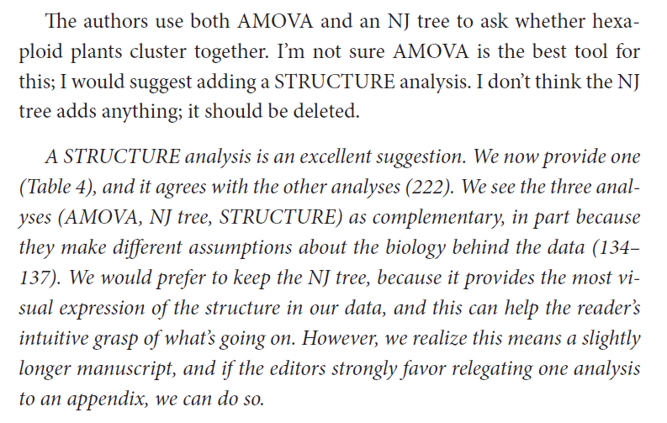

Slide 31
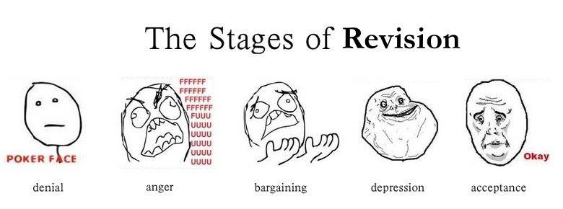
R2R Summary
Readers generally will never see anything in the R2R
However, it can MAKE or BREAK your paper
Deserves the same, if not more, care

Slide 32
Workshop: Respond to Review
Write a brief segment of a Response to Reviews from one of the previous assignments.
You don’t have to make the changes; just pretend you have.
Include at least one response in each of these categories:
change made as suggested
change not made as suggested, but another change made to solve the identified issue
change not made because you disagree with the change. *PRETEND, if needed

Slide 33
Small Group: Game
Active/Passive Voice
Figure/Table Criticisms
If active voice convert to passive, and reverse.
Make any other updates to clarify and shorten sentence
Right answers: 5 points
Wrong answers: 0 points
First right answer: +2 points
Best right answer: +2 points
Each issue identified: 2 points
First group to finish: 2 points

Slide 34
Assignments
Writing
Reviewing
Full Paper Draft
Full Paper

Slide 35
Resources
https://www.ncbi.nlm.nih.gov/pmc/articles/PMC4975196/#:~:text=A%20major%20criticism%20of%20peer,the%20quality%20of%20scientific%20literature
https://journals.plos.org/ploscompbiol/article?id=10.1371/journal.pcbi.1005730
http://ecoevoevoeco.blogspot.com/2015/01/top-ten-best-scientific-figures.html

